Slide 1

RPC & NFS & GFS
Computer System Engineering, Fall 2019. (IPADS, SJTU)
Enable Client/Server model
Yubin Xia

Slide 2


Current Status
We can build a Taobao from scratch on one machine!
Web Server
Accept requests & reply files in HTTP
Socket
File System
inode, FAT, VFS, API, Crash consistency
NIC Driver
Disk Driver
Device controlling, Interrupt handling
System Bus
PIO, MMIO, DMA, Bus transaction
Disk
NIC
Disk structure, SSD, Optimization

Slide 3



Challenges
One machine is NOT enough
More and more pictures to save
More and more clients to serve
Multiple servers are needed
One server with large storage, to save more files
Multiple servers run web server, to server more clients
How to build a Network File System (NFS)?
All nodes can share the global large file system

Slide 4
RPC
Remote Procedure Call

Slide 5
RPC
RPC （Remote Procedure Call)
Allow a procedure to execute in another address space without coding the details for the remote interaction
RPC History
Idea goes back in 1976
Sun's RPC: first popular implementation on Unix
Used as the basis for NFS
RMI (Remote Method Invocation)
Object-oriented version of RPC, e.g. in Java

Slide 6
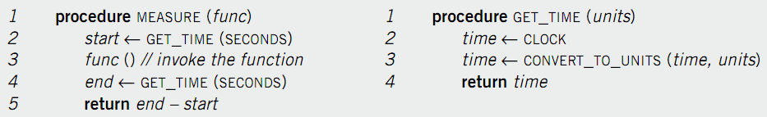
Example of RPC: A Function Call
Re-implement MEASURE and GET_TIME
Run GET_TIME on a server
Call GET_TIME on a client
Notes:
Occam's Razor.

Slide 7
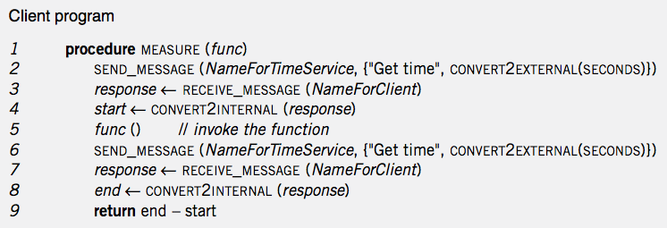
Client Program
Notes:
Marshal: line 2 6
unmarshal: line 4 8

Slide 8
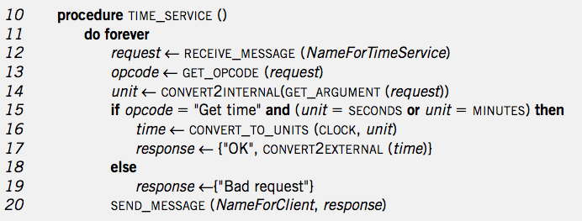
Service Program
Notes:
Marshal: 16-19
Unmarshal: 13 14

Slide 9
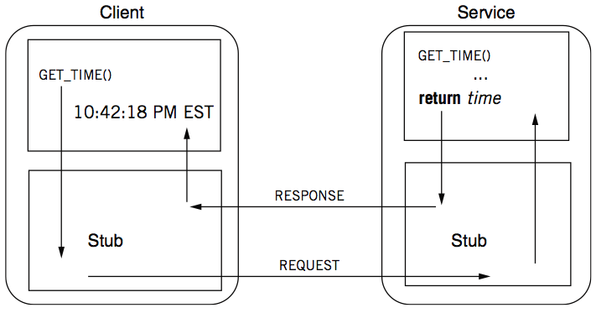
RPC Calling Process

Slide 10
RPC Stub
Client stub
Put the arguments into a request
Send the request to server
Wait for a response
Service stub
Wait for a message
Get the parameters from the request
Call the procedure (e.g. GET_TIME)
Put the result into a response
Send the response to the client
Stub: hide communication details from up-level code, so that up-level code does not change

Slide 11
Client Program using RPC
procedure MEASURE (func)
start <- GET_TIME(SECONDS)
func()
end <- GET_TIME(SECONDS)
return end - start
Note: this code is not changed
This is stub of client
procedure GET_TIME (units)
SEND_MESSAGE(ServerName, {"Get time", CONVERT2EXTERNAL(units)})
response <- RECEIVE_MESSAGE(ClientName)
if GET_RETCODE(response) != "OK"
HANDLE_ERROR(response)
else
return CONVERT2INTERNAL(GET_ARGUMENT(response))
Notes:
Marshal: line 2 6
unmarshal: line 4 8

Slide 12
Server Program using RPC
procedure GET_TIME (units)
time <- CLOCK
time <- CONVERT_TO_UNITS(time, units)
return time
Note: this code is not changed
This is stub of server
procedure TIME_SERVICE ()
do forever
request <- RECEIVE_MESSAGE(ServerName)
opcode <- GET_OPCODE(request)
arg <- CONVERT2INTERNAL(GET_ARGUMENT(request))
if opcode = "Get time" and (arg = SECONDS or arg = MINUTES) then
retval <- GET_TIME(arg)
response <- {"OK", CONVERT2EXTERNAL(retval)}
else
response <- {"Bad request"}
SEND_MESSAGE(ClientName, response)
Notes:
Marshal: line 2 6
unmarshal: line 4 8

Slide 13
Question
What is the content of a message?
Service ID (e.g., function ID)
Service parameter (e.g., function parameter)
Using marshal / unmarshal

Slide 14
RPC Request
UDP header...
Xid
call/reply
rpc version
program #
program version
procedure #
auth stuff
arguments
X is short for "transaction"
Client reply dispatch uses xid
Client remembers the xid of each call
Server dispatch uses prog#, proc#

Slide 15
RPC Reply
UDP header …
Xid
call/reply
accepted? (vs bad rpc version, or auth failure)
auth stuff
success? (vs bad prog/proc #)
results

Slide 16
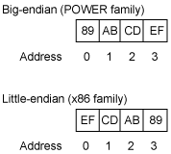
Marshal / Unmarshal
Marshal
Convert an object into an array of bytes with enough annotation so that the unmarshall procedure can convert it back into an object
Serialization is not easy
E.g., big endian VS. little endian
Big endian on network
Two functions: htons(), ntohs()
Using IEEE 754 or not?
What about an array?
What about a pointer?

Slide 17
Automatic Stub Generation
Generate stubs from an interface specification
Tool to look at argument and return types
Generate marshal and unmarshal code
Generate stub procedures
Saves programming (thus less error)
Ensures agreement on argument types
E.g., consistent function ID

Slide 18
RPC System Components
1. Standards for wire format of RPC message and data types
2. Library of routines to marshal / unmarshal data
3. Stub generator, or RPC compiler, to produce "stubs"
For client: marshal arguments, call, wait, unmarshal reply
For server: unmarshal arguments, call real function, marshal reply

Slide 19
RPC System Components
4. Server framework:
Dispatch each call message to correct server stub
5. Client framework:
Give each reply to correct waiting thread / callback
6. Binding: how does client find the right server?

Slide 20
Client Framework
Keeps track of outstanding requests
For each, xid and caller's thread / callback
Matches replies to the callers
Multiple callers may use one socket
Usually handles timing out and retransmitting

Slide 21
Server Framework
Type-1: Create a new thread per request
Master thread reads socket[s]
Type-2: Use a fixed pool of threads
Use a queue if too many requests
E.g., NFS server
Type-3: Just one thread for serial execution
Simplifies concurrency, e.g., the X server

Slide 22
Case Study: NFS

Slide 23
NFS (Network File System)
History
Sun Inc., 1980s, designed for workstations
Centralized management: easy to share & backup files
Cost benefit: workstations without disks
NFS goals
Transparency: compatibility with existing applications
OS independent: clients even in DOS
Easy to deploy
# mount –t nfs 10.131.250.6:/nfs/dir /mnt/nfs/dir

Slide 24
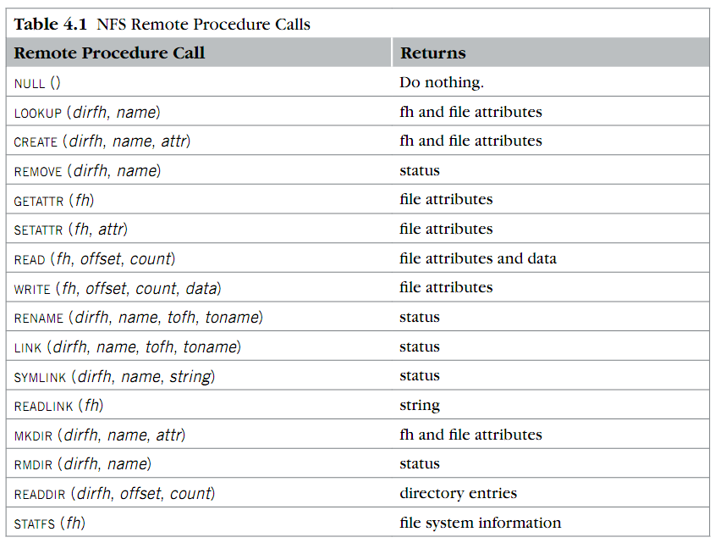
RPC in NFS
Where is OPEN and CLOSE?

Slide 25
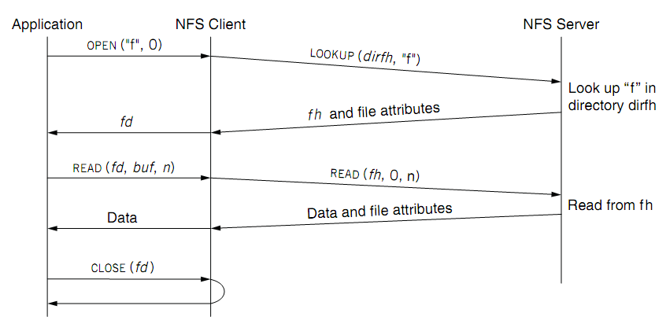
NFS Overview
fd <--> fh (file handler)
No state after open()

Slide 26
File Handler for a Client
File handler contains three parts
File system identifier: for server to identify the file system
inode number: for server to locate the file
Generation number: for server to maintain consistency of a file
Can still work across server failures
E.g., server reboot
Q: Why not put path name in the handle?

Slide 27
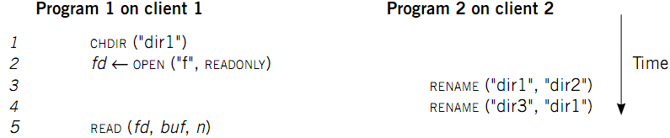
Case 1: Rename After Open
UNIX Spec:
Program 1 should read "dir2/f"
NFS should keep the spec

Slide 28
Stateless on NFS server
Stateless on NFS server
Each RPC contains all the information
Q: What about states like file cursor?
Client maintains the states, including the file cursor
Client can repeat a request until it receives a reply (at least once)
Server may execute the same request twice
Solution: each RPC is tagged with a transaction number, and server maintains some "soft" state: reply cache
Q: What if the server fails between two same requests?
Notes:
What about the case of "delete-after-open"?

Slide 29
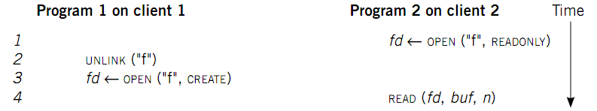
Case 2: Delete after Open
UNIX spec:
On local FS, program 2 will read the old file
How to avoid program 2 reading new file?
Generation number
"stale file handler"
Not the same as UNIX spec! It's a tradeoff...

Slide 30
Cache on the Client
NFS client maintains various caches
Stores a vnode for every open file
Know the file handles
Recently used vnodes, attributes, recently used blocks, mapping from path name to vnode
Cache benefits
Reduce latency
Less RPC, reduce load on server
Cache coherence is needed

Slide 31
Coherence
Read/write coherence
On local file system, READ gets newest data
On NFS, client has cache
NFS could guarantee read/write coherence for every operation, or just for certain operation
Close-to-open consistency
Higher data rate
GETATTR when OPEN, to get last modification time
Compare the time with its cache
When CLOSE, send cached writes to the server
Notes:
Mixed blocks, old and new

Slide 32
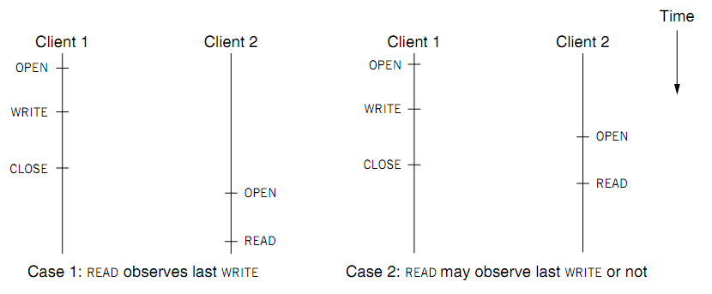
Coherence
Two cases of close-to-open consistency
More contents of consistency in chapter 9 and 10

Slide 33
Extend the UNIX FS to support NFS
Vnode
Abstract whether a file or directory is local or remote
In volatile memory (why?)
Support several different local file system
Where should vnode layer be inserted?
Vnode API
Same as we learnt: OPEN, READ, WRITE, CLOSE…
Code of fd_table, current dir, file name lookup, can be moved up to the file system call layer

Slide 34
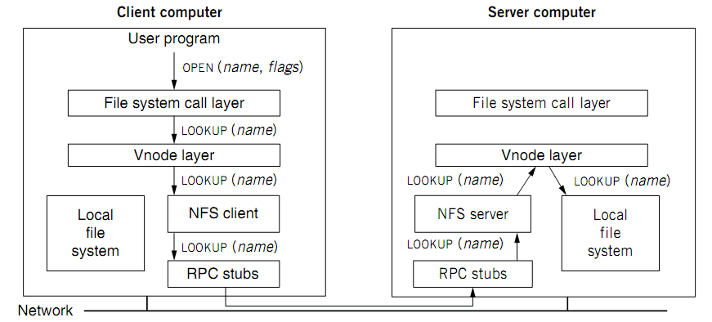
Extend the UNIX FS to support NFS

Slide 35
Reference Materials
Textbook
Chapter 4.2 & 4.5
RFC 1831: RPC Specification
http://www.ietf.org/rfc/rfc1831.txt?number=1831
RFC 1832: XDR Specification
http://www.ietf.org/rfc/rfc1832.txt?number=1832

Slide 36
Client & Server (C/S Model)
Enforced modularity

Slide 37
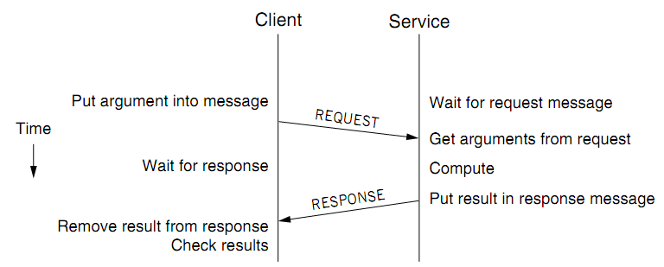
Client/Service Organization
Limit interactions to explicit messages
Client: request; service: response or reply
On different computers, connected by a wire
Chap 5 will explain how to get them into one computer

Slide 38
C/S Model
Client/Service model
Separates functions (abstraction)
Enforces that separation (enforced modularity)
Reduce fate sharing but not eliminate it
Notes:
Occam's Razor.

Slide 39
Multiple Clients and Services
One services can work for multiple clients
E.g., one file server for multiple clients
One client can use several services
E.g., one client can connect to multiple file servers
One module can be both a client and a service
E.g., printer as a service for printing request, while also as a client of the file service

Slide 40
Trusted Intermediaries
Service as trusted 3rd party
Run critical procedures as a service
E.g., a file service to keep clients' file distinct, email service
Enforces modularity among multiple clients
Ensures that a fault in one client has limited effect on another client
Thin client computing (the ultimate version of C/S?)
Simplify clients by having the trusted intermediary provide most functions
Only the trusted intermediaries run on powerful computers
What if the powerful computers fail…

Slide 41
RPC != PC
RPCs can reduce fate sharing
Set a time-out for message lost or service failure
RPCs introduce new failures: no response
RPCs take more time
Stub itself may cost more than a service
Consider using RPC in device driver: time-out error
Not suitable for all cases

Slide 42
RPC: Failure Handling
Most network systems and applications also have these considerations
1. At least once
Client keeps resending until server responds
Only OK if without side effects on server
2. At most once
Client keeps resending (may time-out)
Server remembers requests and suppress duplicates?
Idempotent functions
3. Exactly once
This is often what we really want
Hard to do in a useful way, later in Chap-8 and 10
Most RPC systems do #1 or #2

Slide 43
Other Differences
Language support
Some features do not combine well with RPC
E.g., inter-procedure communicate through global variable
Data structure that contains pointers
Security consideration
Both client and server need authentication
Side channel attacks through network pattern

Slide 44
Questions
Q: Why RPC and C/S?
Programmers make mistakes
Mistakes propagate easily
Enforce modularity
Q: What does RPC do, exactly? Can we use other ways?
E.g., socket? HTTP? Why not use them?
Be more friendly for programmers

Slide 45
GFS

Slide 46
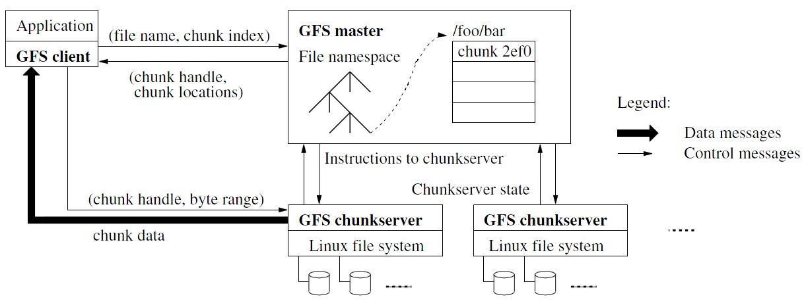
Architecture

Slide 47
Design Architecture
GFS Cluster (accessed by clients)
Single Master + Multiple Chunkservers
Chunkserver
Files of fixed sized chunks
Each chunk has a globally unique 64-bit chunk handle.
Master
Maintains file system metadata
Namespace
Access Control Information
Mapping from files to chunks
Current locations of chunks

Slide 48
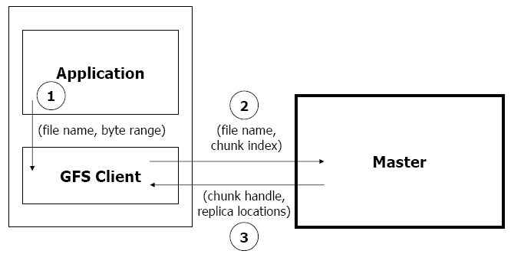
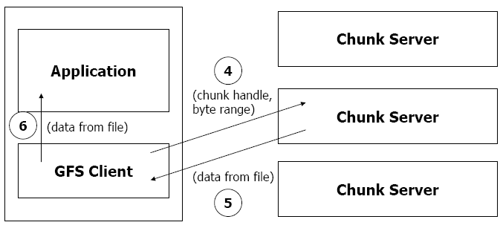
Read Algorithm

Slide 49
Read Algorithm
1. Application originates the read request.
2. GFS client translates the request from (filename, byte range) -> (filename, chunk index), and sends it to master.
3. Master responds with chunk handle and replica locations (i.e. chunk servers where the replicas are stored).
4. Client picks a location and sends the (chunk handle, byte range) request to that location.
5. Chunk server sends requested data to the client.
6. Client forwards the data to the application.

Slide 50
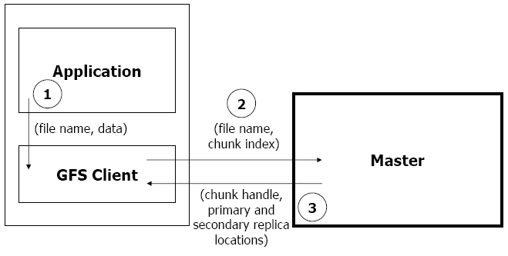
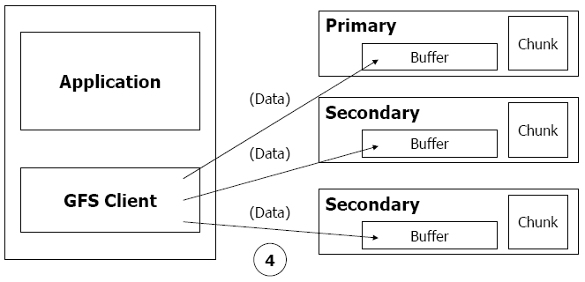
Write Algorithm

Slide 51
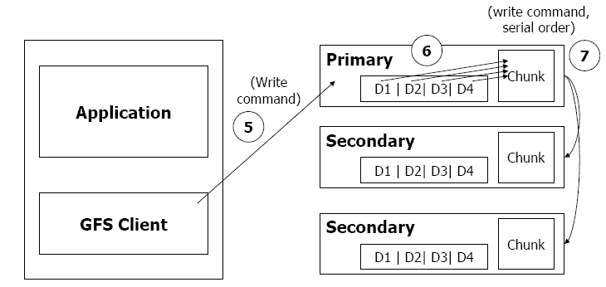
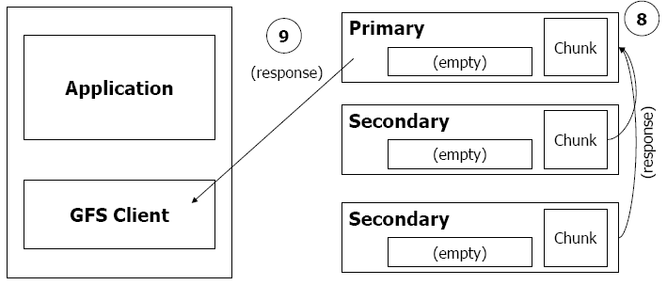
Write Algorithm

Slide 52
Write Algorithm
1. Application originates write request.
2. GFS client translates request from (filename, data) -> (filename, chunk index), and sends it to master.
3. Master responds with chunk handle and (primary + secondary) replica locations.
4. Client pushes write data to all locations. Data is stored in chunkservers' internal buffers.
5. Client sends write command to primary.

Slide 53
Write Algorithm
6. Primary determines serial order for data instances stored in its buffer and writes the instances in that order to the chunk.
7. Primary sends serial order to the secondaries and tells them to perform the write.
8. Secondaries respond to the primary.
9. Primary responds back to client.
Note: If write fails at one of chunk servers, client is informed and retries the write.

Slide 54
Design Architecture
Principle: data flow is decoupled from control flow
Clients interact with the master for metadata operations
Clients interact directly with chunkservers for all files operations
This means performance can be improved by scheduling expensive data flow based on the network topology
Neither the clients nor the chunkservers cache file data
Working sets are usually too large to be cached, chunkservers can use Linux's buffer cache

Slide 55
Single Master Node
Clients do not read or write through the master
The master relays relevant chunkserver location information to the client
The client temporarily caches the chunkserver data and directly accesses the chunkserver
Shadow Masters (for fault tolerance)

Slide 56
Metadata on Master
Metadata is stored in memory
Namespaces and file-to-chunk mappings are also stored persistently in operation log
Master monitors chunk location through heartbeat messages with each chunk
The namespace metadata
Master does not use any per-directory data structures
No inodes! No symlinks or hard links, either
Every file and directory is represented as a node in a lookup table, mapping pathnames to metadata
Stored efficiently using prefix compression
< 64 bytes per namespace entry

Slide 57
Chunkserver
Contains chunks (blocks, each 64MB) of a fixed size
Fewer chunk location, fewer metadata (all in memory)
Chunks are replicated regularly
Default: 3-way mirror (across machines and racks)
Talks with master through heartbeat messages
Master determines chunk locations and assesses state of the overall system
The chunkserver has the final word over what chunks it does or does not have on its own disks – not the master

Slide 58
Why a Single Master?
The master now has global knowledge of the whole system, which drastically simplifies the design
But the master is (hopefully) never the bottleneck
Clients never read and write file data through the master; client only requests from master which chunkservers to talk to
Master can also provide additional information about subsequent chunks to further reduce latency
Further reads of the same chunk don't involve the master, either

Slide 59
Why a Single Master?
Master state is also replicated for reliability on multiple machines, using the operation log and checkpoints
If master fails, GFS can start a new master process at any of these replicas and modify DNS alias accordingly
"Shadow" masters also provide read-only access to the file system, even when primary master is down
They read a replica of the operation log and apply the same sequence of changes
Not mirrors of master: they lag primary master by fractions of a second
This means we can still read up-to-date file contents while master is in recovery!

Slide 60
Fault Tolerance and Diagnosis
Fast recovery
Master and chunkserver are designed to restore their states and start in seconds
Chunk replication : 3-way mirrors
Across multiple machines, across multiple racks

Slide 61
Fault Tolerance and Diagnosis
Master Mechanisms:
Log of all changes made to metadata
Periodic checkpoints of the log
Log and checkpoints replicated on multiple machines
Master state is replicated on multiple machines
"Shadow" masters for reading data if "real" master is down

Slide 62
Fault Tolerance and Diagnosis
Data integrity
A chunk is divided into 64-KB blocks
Each with its 32-bit checksum
Verified at read and write times
Also scans for rarely used data in background

Slide 63
Typical Workloads on GFS
Two kinds of reads: large streaming reads & small random reads
Large streaming reads usually read 1MB or more
Oftentimes, applications read through contiguous regions in the file
Small random reads are usually only a few KBs at some arbitrary offset
Also many large, sequential writes that append data to files
Similar operation sizes to reads
Once written, files are seldom modified again
Small writes at arbitrary offsets do not have to be efficient
Multiple clients (e.g. ~100) concurrently appending to a single file
e.g. producer-consumer queues, many-way merging

Slide 64
Summary of GFS
Runs on commodity hardware and is scalable
Performs well for the specified tasks and assumptions previously mentioned
Innovation
File system API tailored to stylized workload
Single-master design to simplify coordination
Metadata fit in memory

Slide 65
Summary of GFS
Flat namespace
Dedicated Care for Component Failure
hard disk failure, data corruption, network disconnection, etc.
High-throughput
Minimized the master involvement
Chunk servers themselves send and receive the client data
The master leases authority to mutate chunks

